Slide 1

Evaluation of Various Sensing Modalities for Accurate Measurement of Neck Flexion Angle during Thyroid and Ear Surgery
Team Member : Zhen Hu, Hanqing Duan
Mentor: Dr. Russell Taylor, Dr. Deepa Galaiya

Slide 2
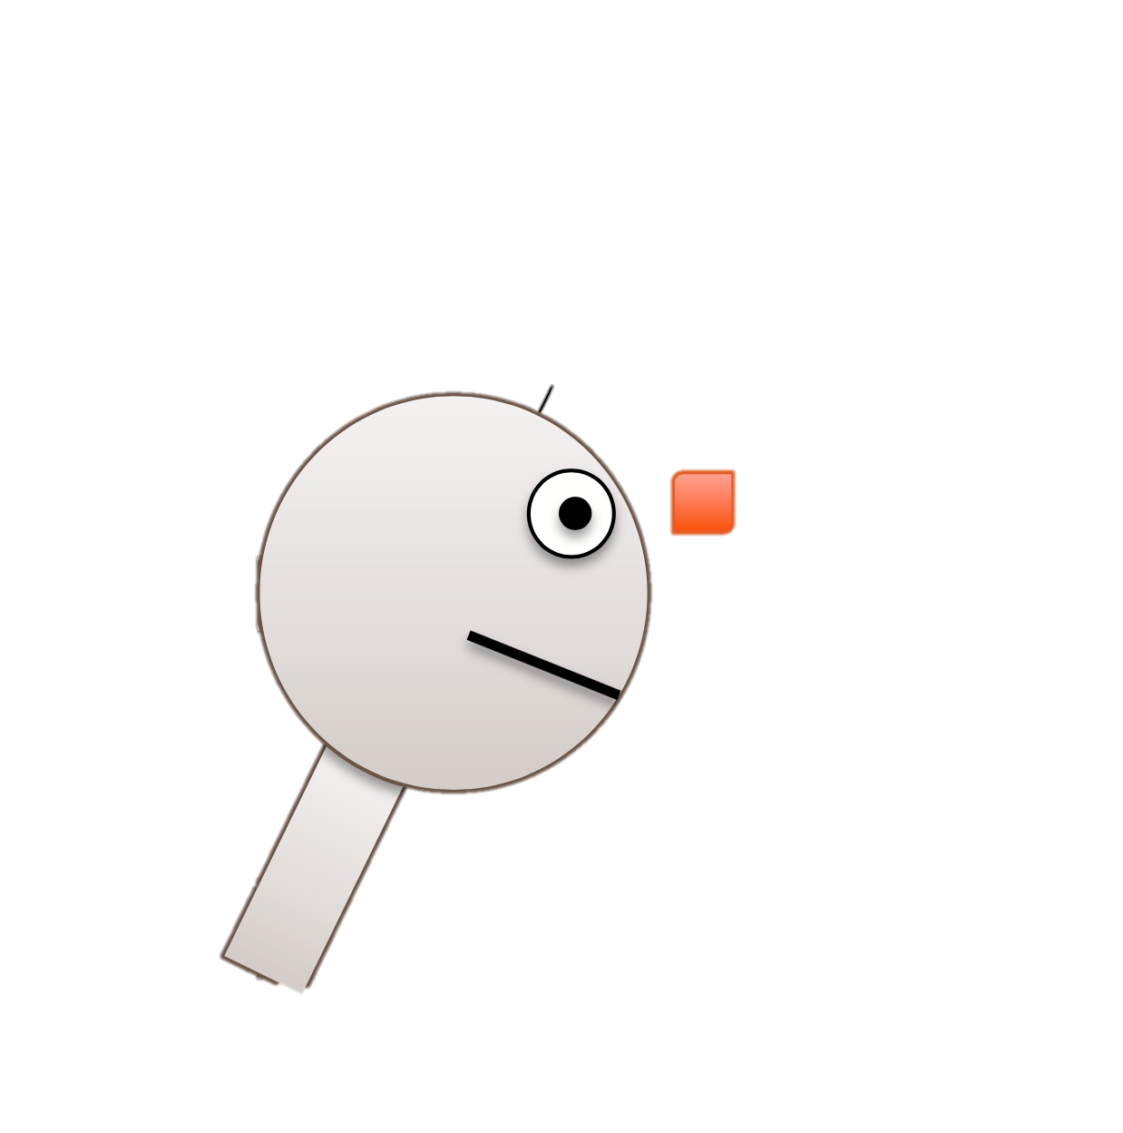
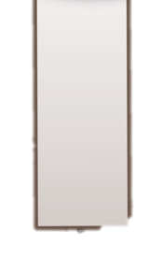


Project Summary
A6
Goal: Accurate Measurement of Neck Flexion Angle during Thyroid and Ear Surgery by using IMUs
IMU: Inertial measurement unit
Accurate: Calibrate IMUs’ pitch angle against EM tracker
Neck Flexion Angle: extract pitch angle between two IMUs
Surgeries: Analyze neck flexion angle changes in real surgical scenarios if possible
$$θ$$
1A
Figure Edit from: https://stanford.edu/class/ee267/lectures/lecture10.pdf
Notes:
To investigate and compare postural ergonomics of surgeons during two different surgical scenarios

Slide 3
Deliverables Update
Blue: Add & Revise;
Red: Delete;
Minimum:
Calibration result of two IMUs separately against EM tracker (excel file)
Documentation of software setting and calibration steps (doc file)
Expected:
Data analysis report of mock OR surgery data
Maximum:
Data analysis report of real surgical scenarios
Clinical paper
(Linear regression function)
Emergency surgeries
all possible surgeries
Simulation surgeries for residents
Final report

Slide 4
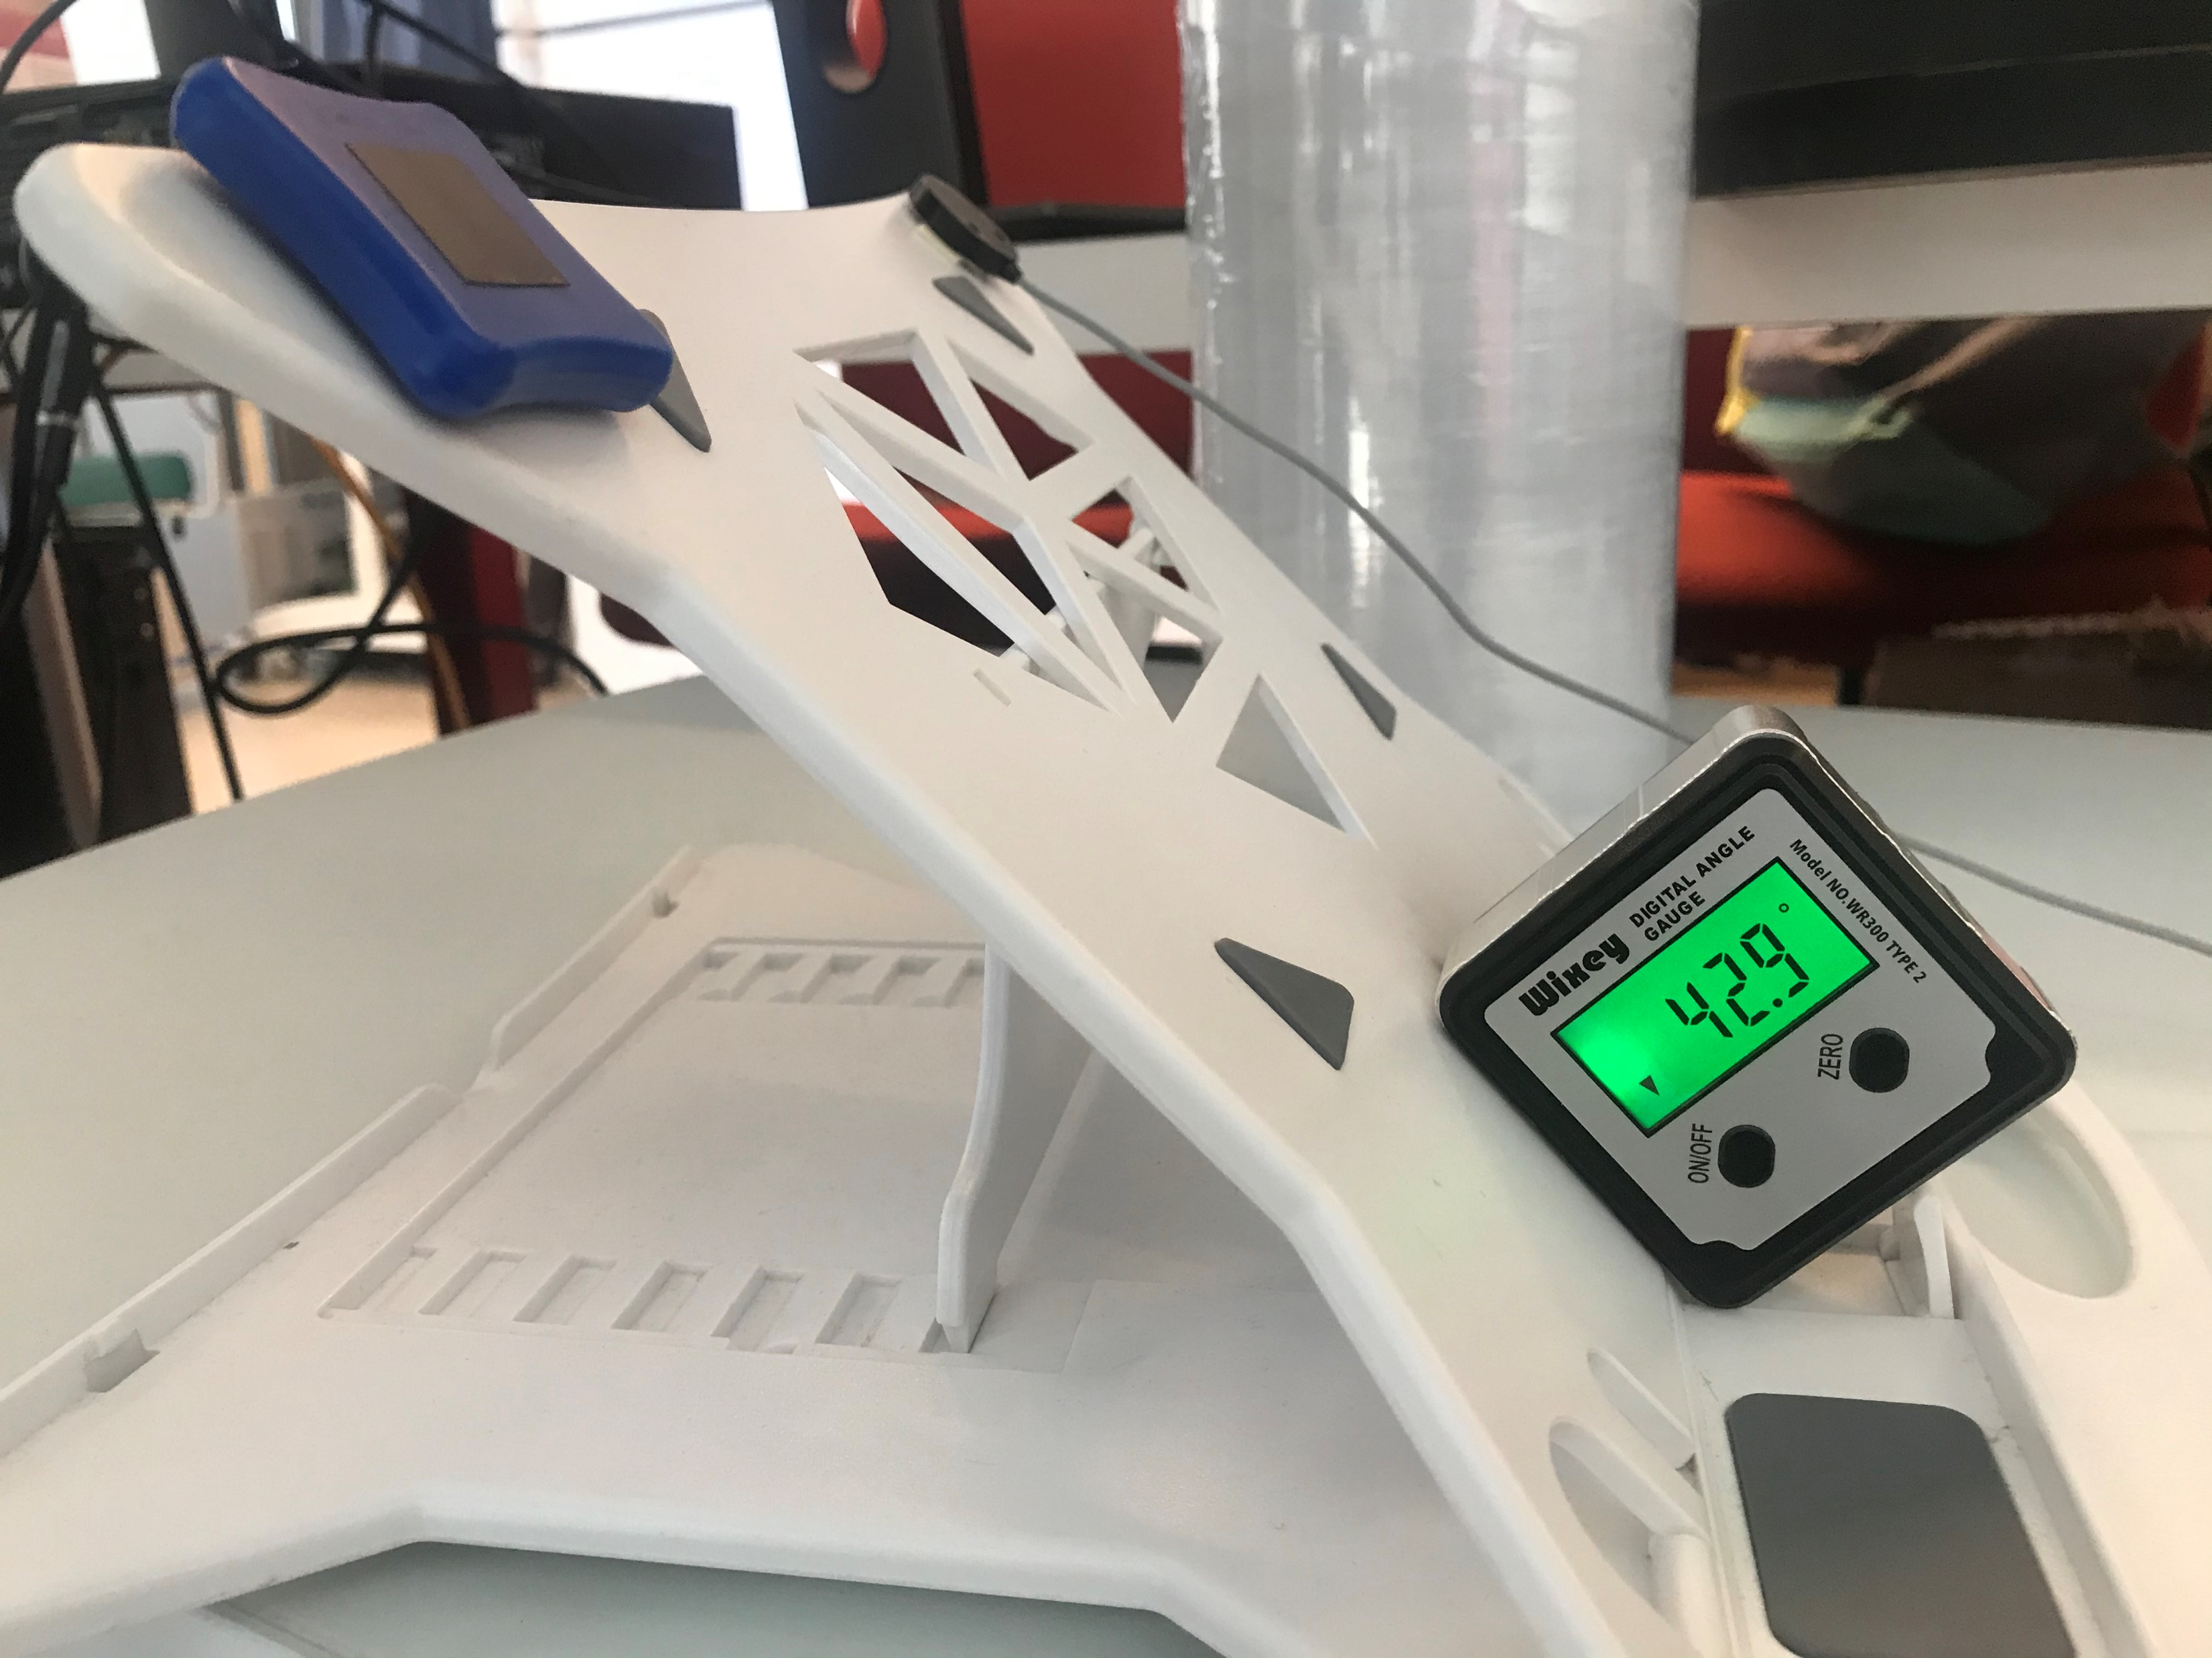
Calibration Method – Set up
One IMU vs one EM tracker – ground truth
Stick IMUs and EM tracker at the same plane
Use the laptop stand to change angles
Collect Quaternion data for two IMUs and EM trackers with 9 different angles for a while by using rosbag in Linux
One for reference (horizontal plane)
Eight for different pitch angle samples
Last a while for averaging to remove noise
EM tracker
IMU
Laptop Stand
Notes:
IMU and EM tracker cannot be banded together because of magnetic field
Stable for a while at 9 different angles
Collect data at the same time

Slide 5

Calibration Method – Pitch angle calculation
Average rotation of the elements of quaternions by using meanrot function in MATLAB
Calculate flexion angle mathematically by using two quaternions
$q_{1}$: reference $q_{2}$: one of the eight different pitch angle samples
$Flexion angle=2∗\operatorname{atan}{2\left({||q}_{1}^{∗}q_{2}(x,y,z)||,q_{1}^{∗}q_{2}(w\right))} ∗\frac{π}{180}\left(degree\right)$
Flexion angle from EM tracker (degree) | Flexion angle from IMU 1A (degree) | Flexion angle from IMU A6 (degree)
26.6346 | 27.6527 | 27.6778
32.6116 | 33.3907 | 33.4102
37.8730 | 38.5087 | 38.4184
42.1996 | 42.6490 | 42.52
45.7238 | 46.0262 | 45.8209
48.4941 | 48.6611 | 48.4686
50.2905 | 50.4428 | 50.2339
52.8936 | 53.3970 | 53.1683

Slide 6
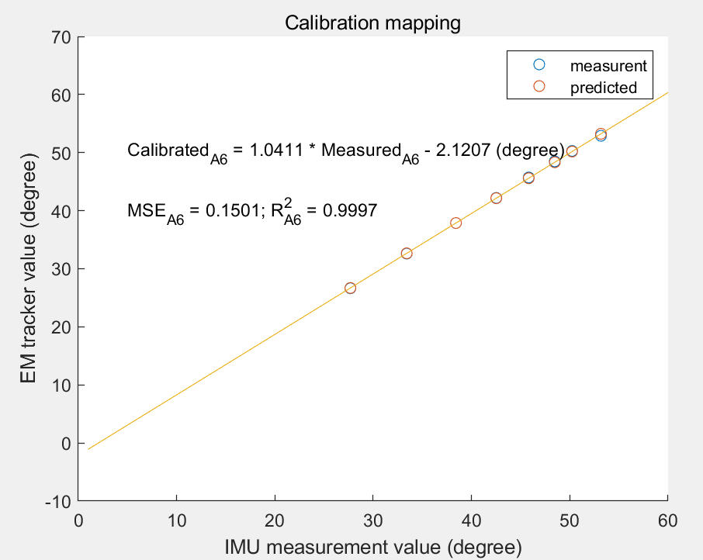
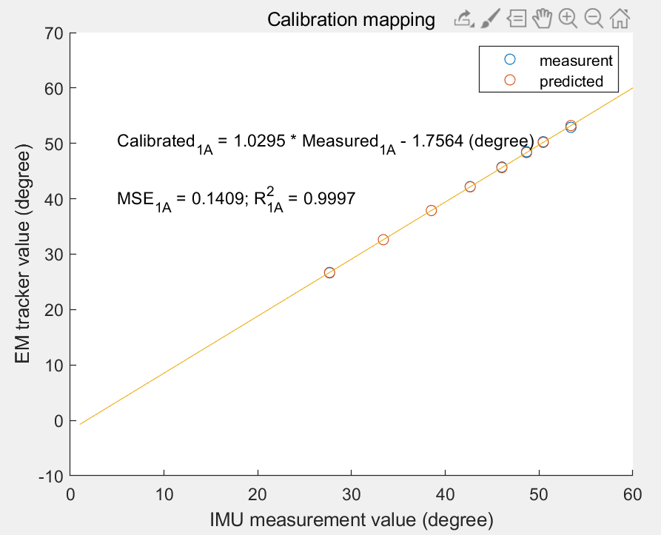
Calibration Method – Linear regression
Do linear regression for both IMU A6 and 1A with EM tracker using samples data

Slide 7
Neck Flexion Angle Model
At the beginning, surgeon stands and stays unmoved: reference position
While surgeon operating: other positions
For two IMUs:
both reference and others
For two IMUs:
both reference and others
Derive Euler Angle
Calibrate Pitch Component
Derive Rotation Matrix R
Derive Pitch Angle
Derive Rd required to go from 1A to A6
Derive R’ w.r.t. Reference
For two IMUs

Slide 8
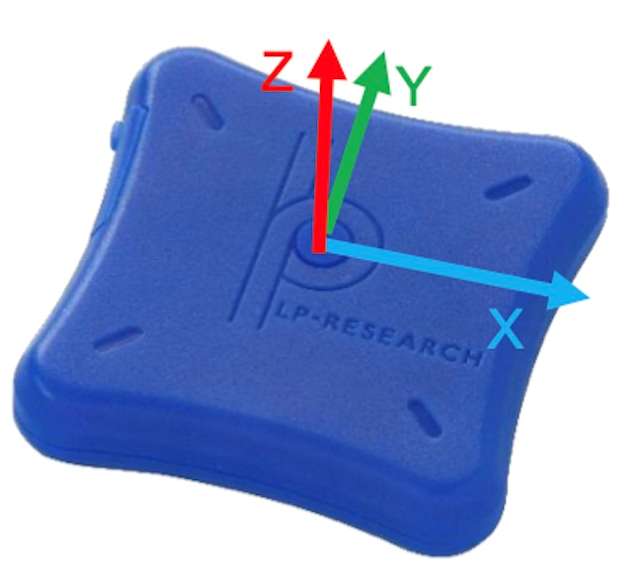
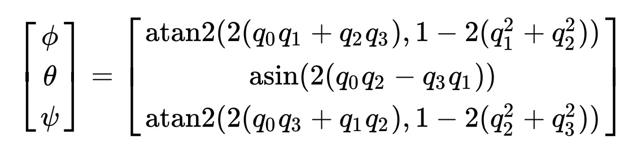
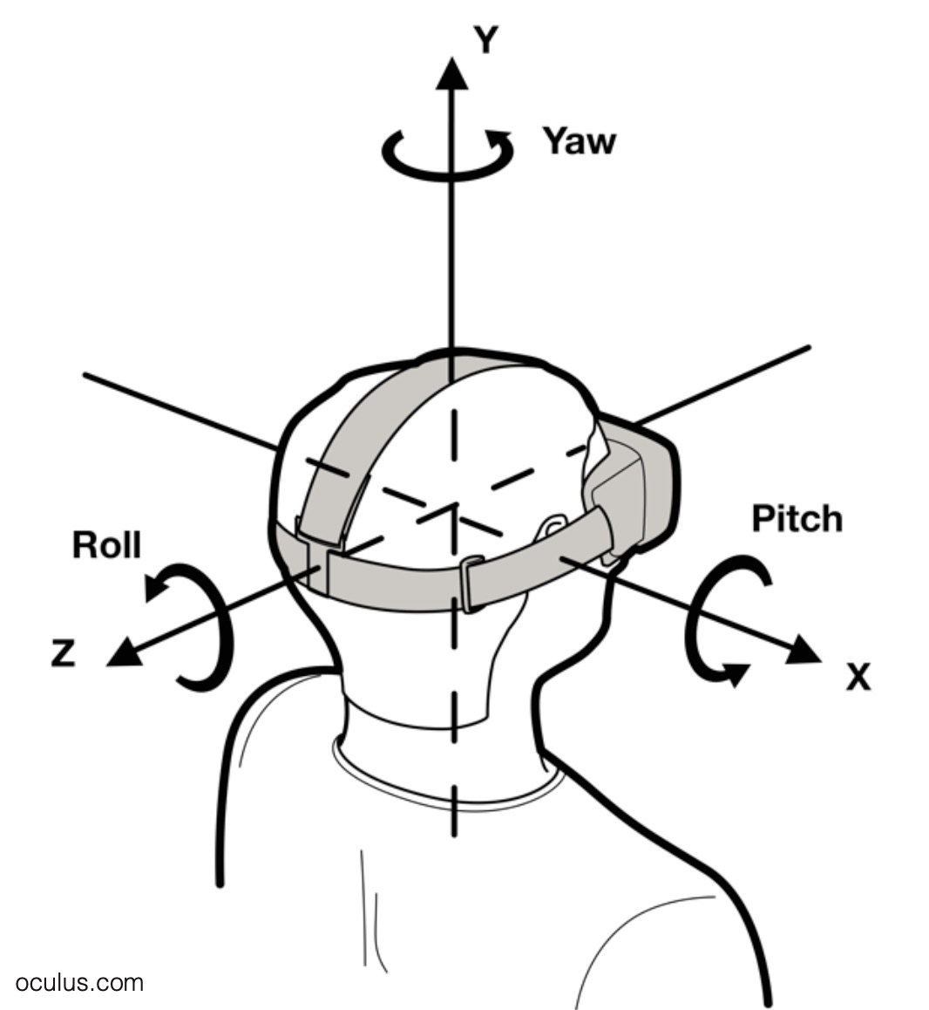
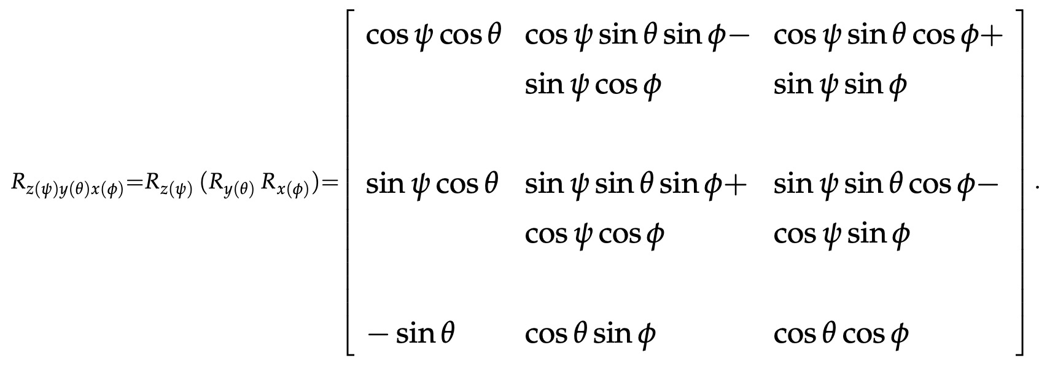

Neck Flexion Angle Model
Upper Figure from: LPMS-B2 Series Hardware Manual ver 1.0
Step1: Derive the Euler angles with ‘ZYX’ sequence from quaternions, then use the linear regression equation got before to calibrate the pitch angle.
Step2: Calculate the ‘ZYX’ rotation matrix $R_{A6r}, R_{1Ar}$of the reference, $R_{A6o}, R_{1Ao}$of other calibrated Euler angles
—
= -
+
—
Lower Figure from: https://stanford.edu/class/ee267/lectures/lecture10.pdf

Slide 9
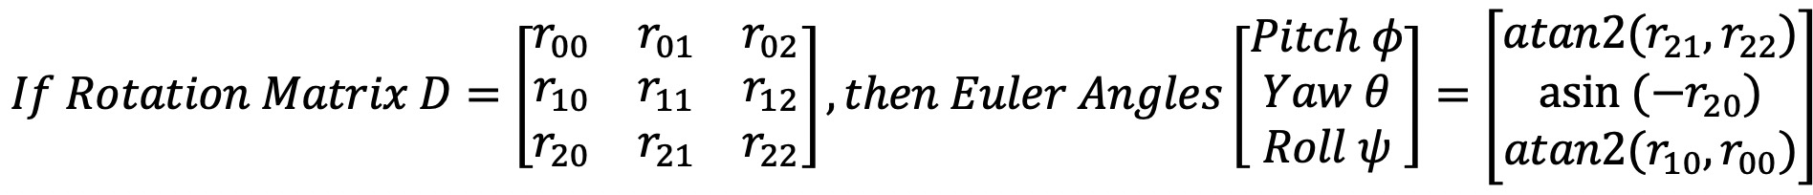

Neck Flexion Angle Model
Upper Figure from: LPMS-B2 Series Hardware Manual ver 1.0
Step3: Calculate the rotation matrix $R_{A6}, R_{1A}$with respect to reference position, $R_{A6}=R_{A6o}^{T}R_{A6r}$
Step4: Calculate the rotation matrix $D$required to go from IMU 1A position to IMU A6 position, $D=R_{A6}^{T}R_{A1}$
Step5: Derive the pitch/yaw/roll angles from the matrix $D$
Lower Figure from: https://stanford.edu/class/ee267/lectures/lecture10.pdf

Slide 10
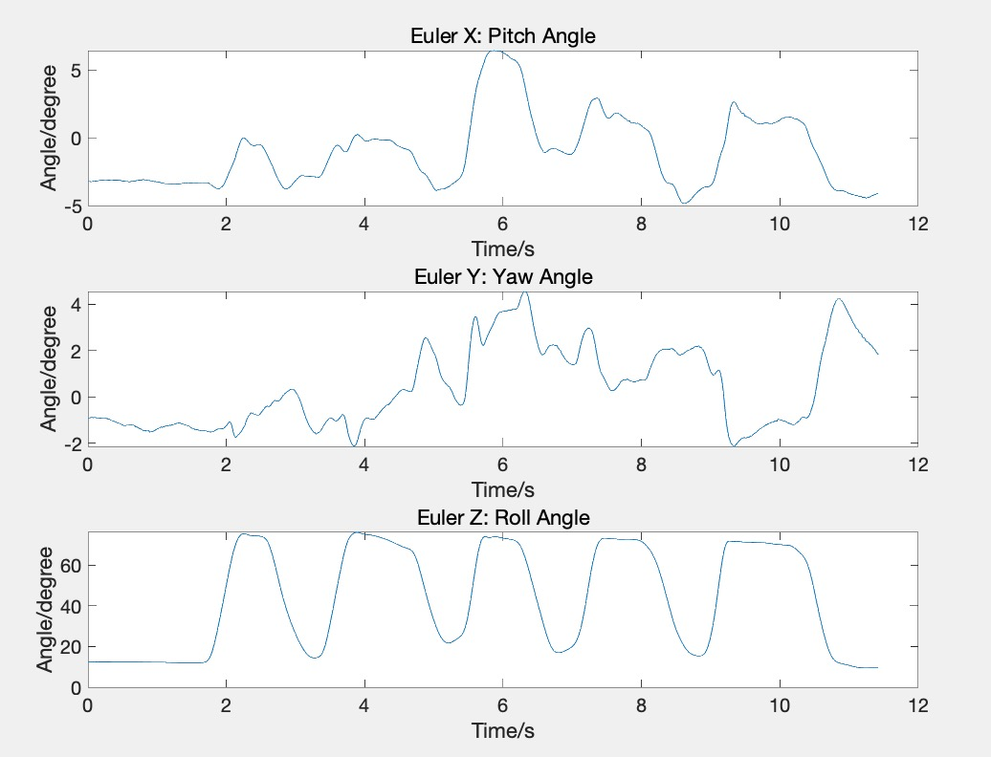
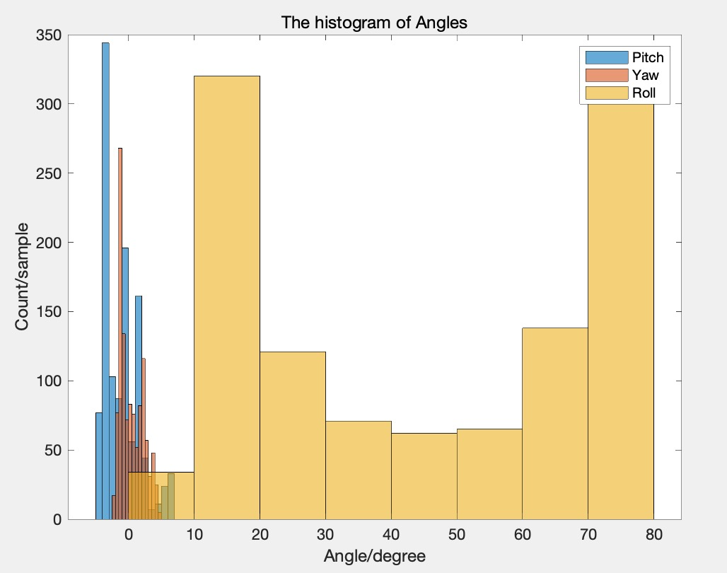
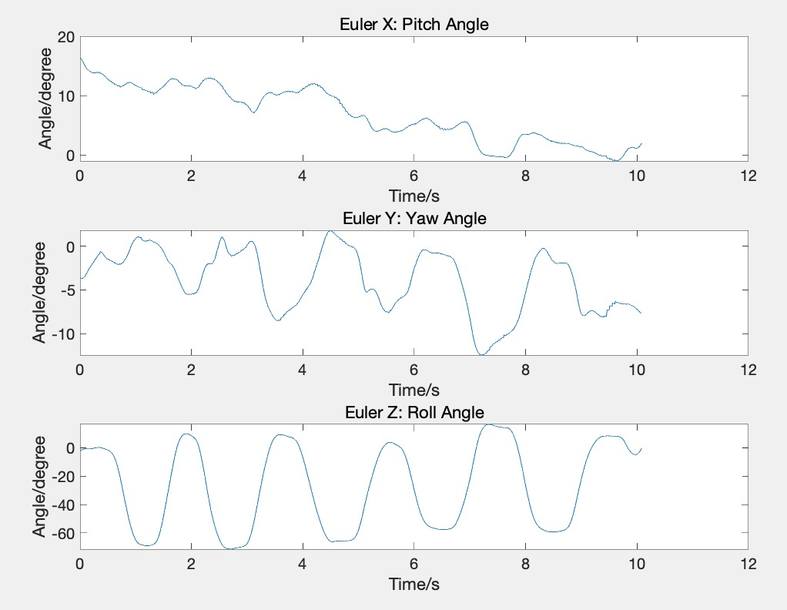
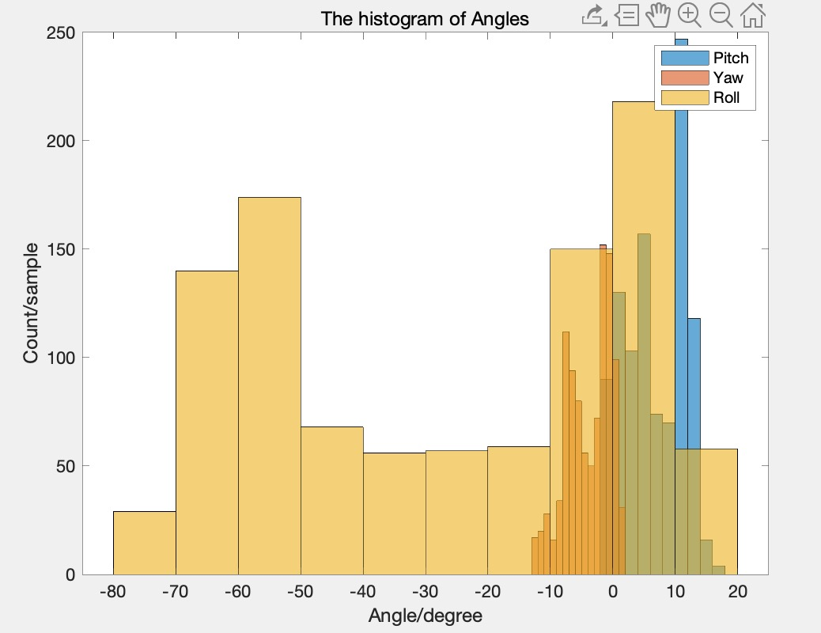
Mock OR Data Analysis – rotate to left & right
Rotate to left
Roll angle changes between 0 degree to 80 degree periodically.
Rotate to
right
Roll angle changes between -80 degree to 20 degree periodically.
Pitch angle and Yaw angle change little and there is no significant difference between left and right circumstances.
Coordinate system figure from: https://stanford.edu/class/ee267/lectures/lecture10.pdf

Slide 11
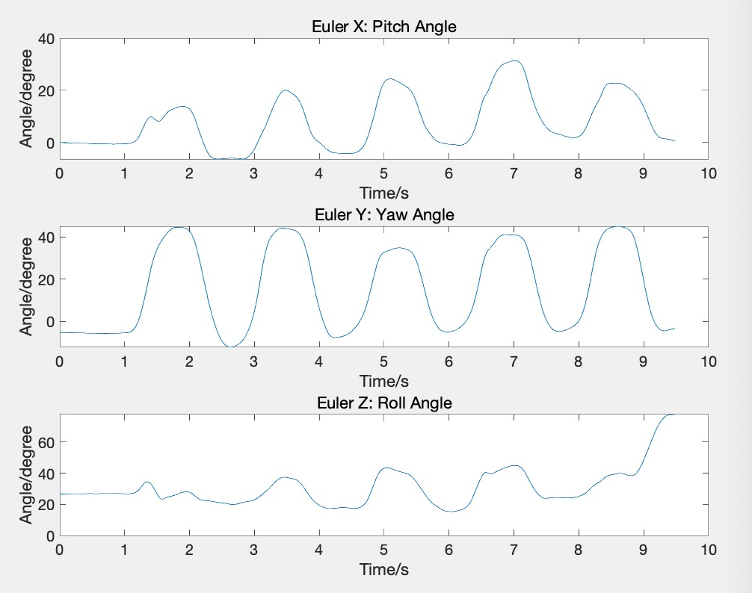
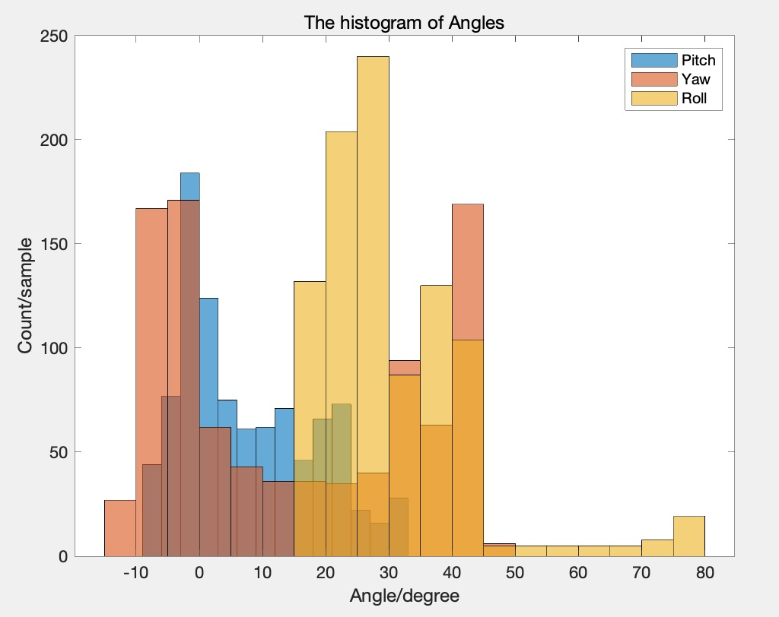
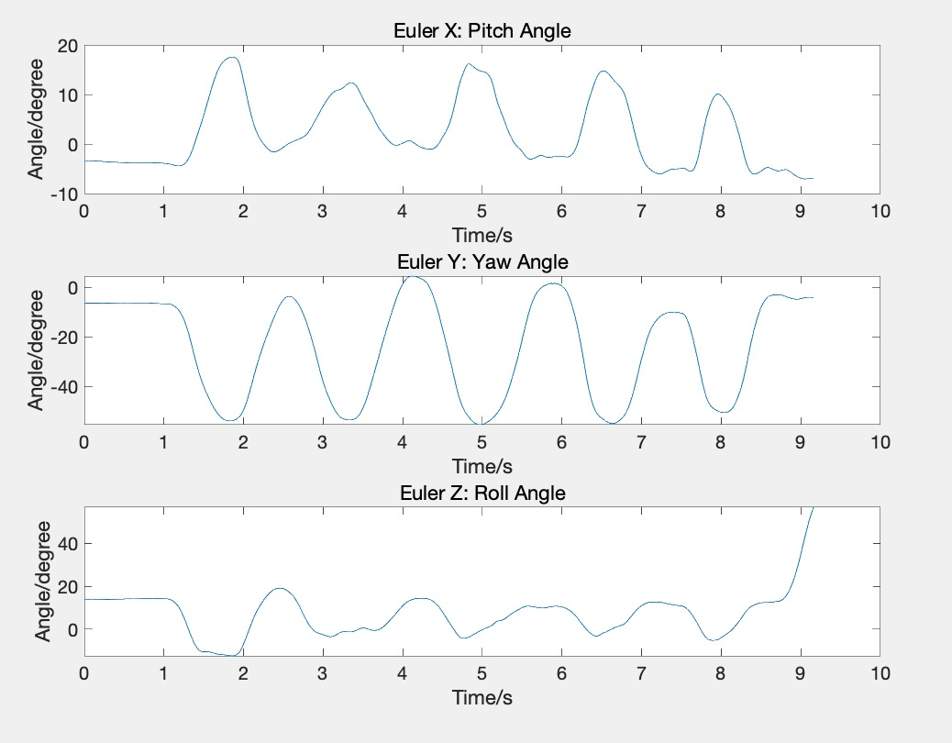
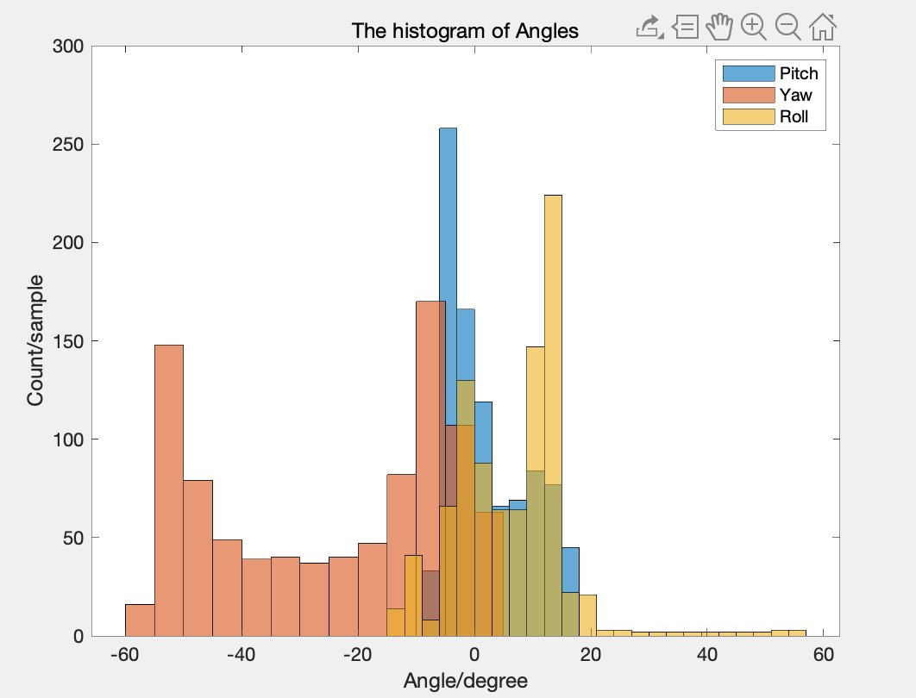
Mock OR Data Analysis – turn to left & right
Turn to left
Yaw angle changes between -10 degree to 45 degree periodically.
Turn to right
Yaw angle changes between -60 degree to 5 degree periodically.
Pitch angle and Roll angle change little and there is no significant difference between left and right circumstances.
Coordinate system figure from: https://stanford.edu/class/ee267/lectures/lecture10.pdf

Slide 12
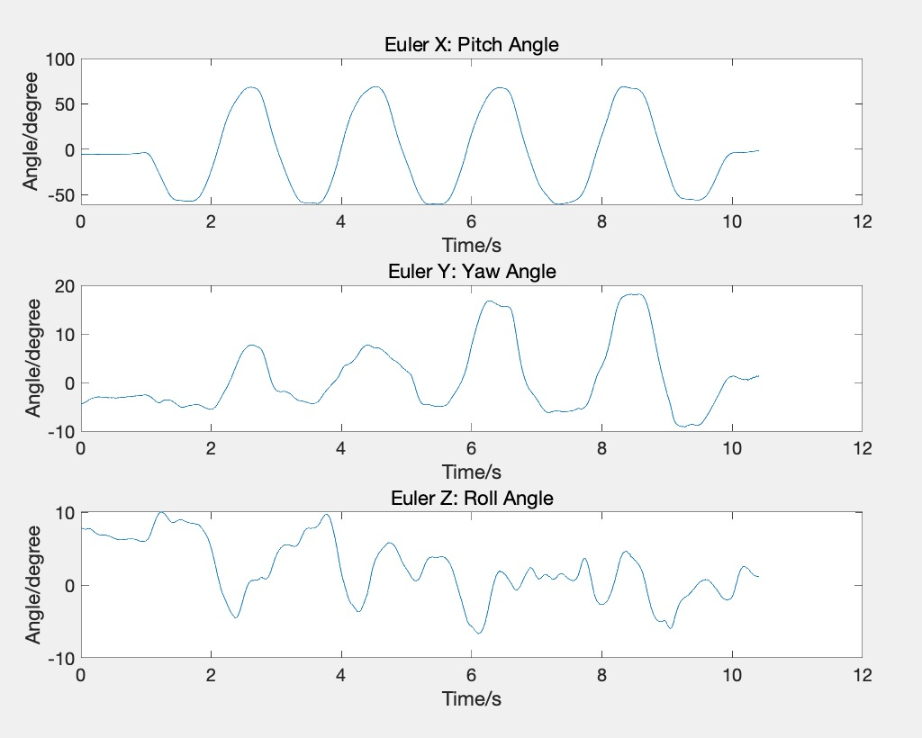
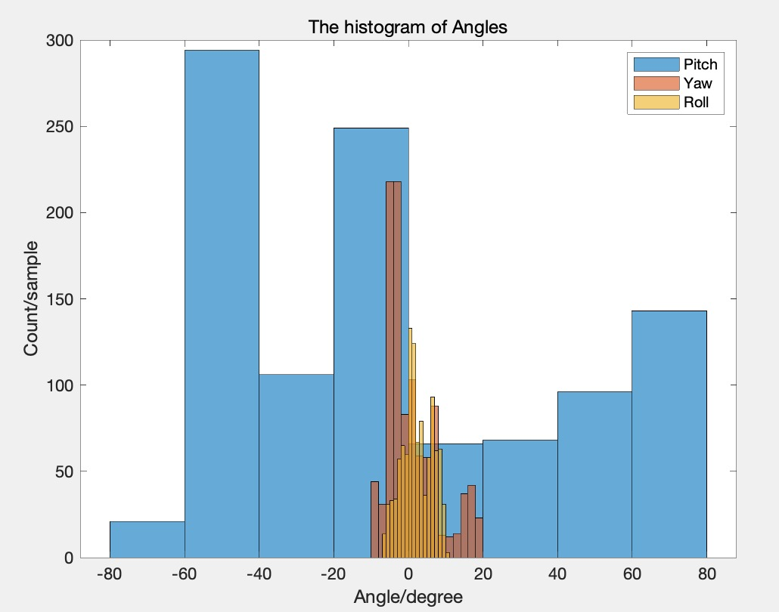
Mock OR Data Analysis – turn up and down
Pitch angle changes between -80 degree to 80 degree strongly and periodically.
Yaw angle and Roll angle changes little.
Coordinate system figure from: https://stanford.edu/class/ee267/lectures/lecture10.pdf

Slide 13
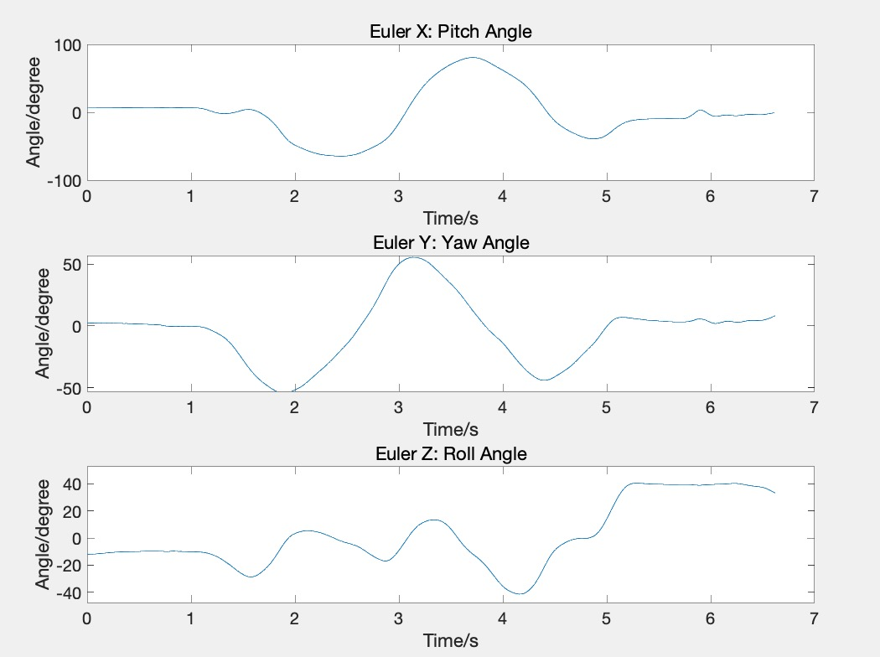
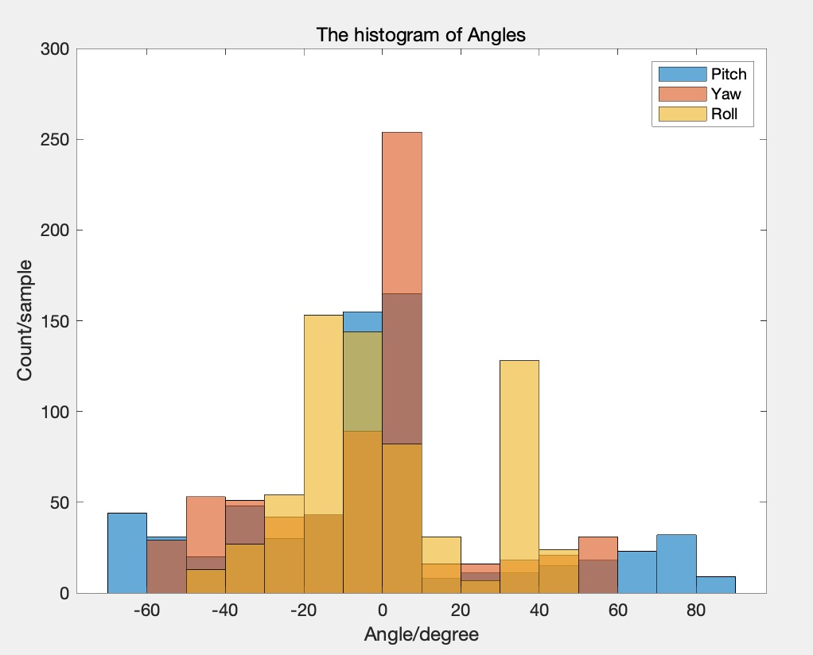
Mock OR Data Analysis – rotate circle
Pitch angle and Yaw angle change in a circle.
Roll angle changes randomly.
Coordinate system figure from: https://stanford.edu/class/ee267/lectures/lecture10.pdf

Slide 14
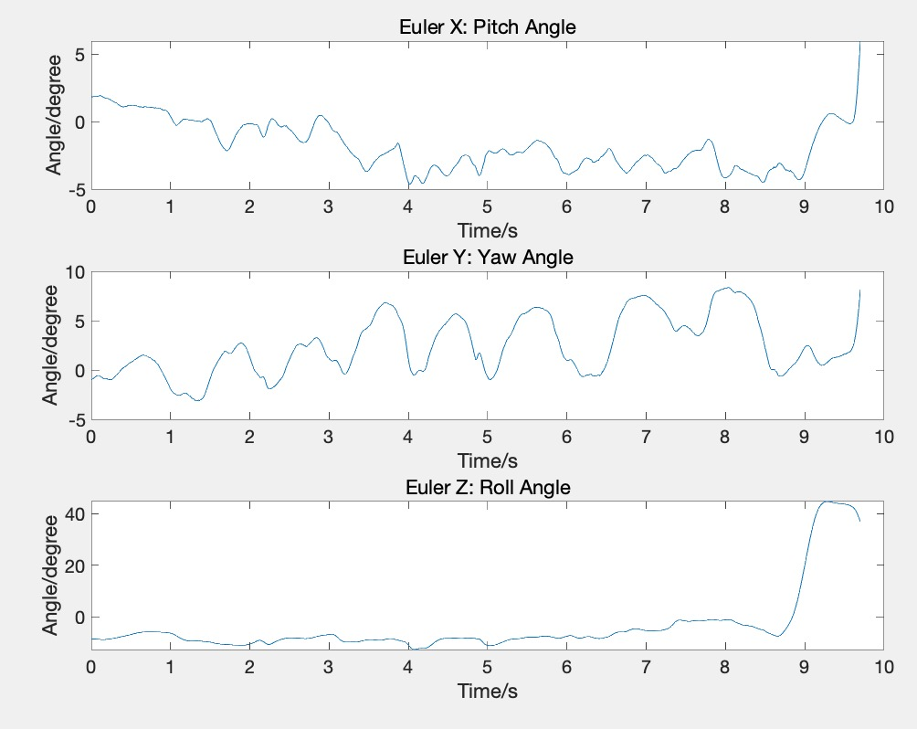
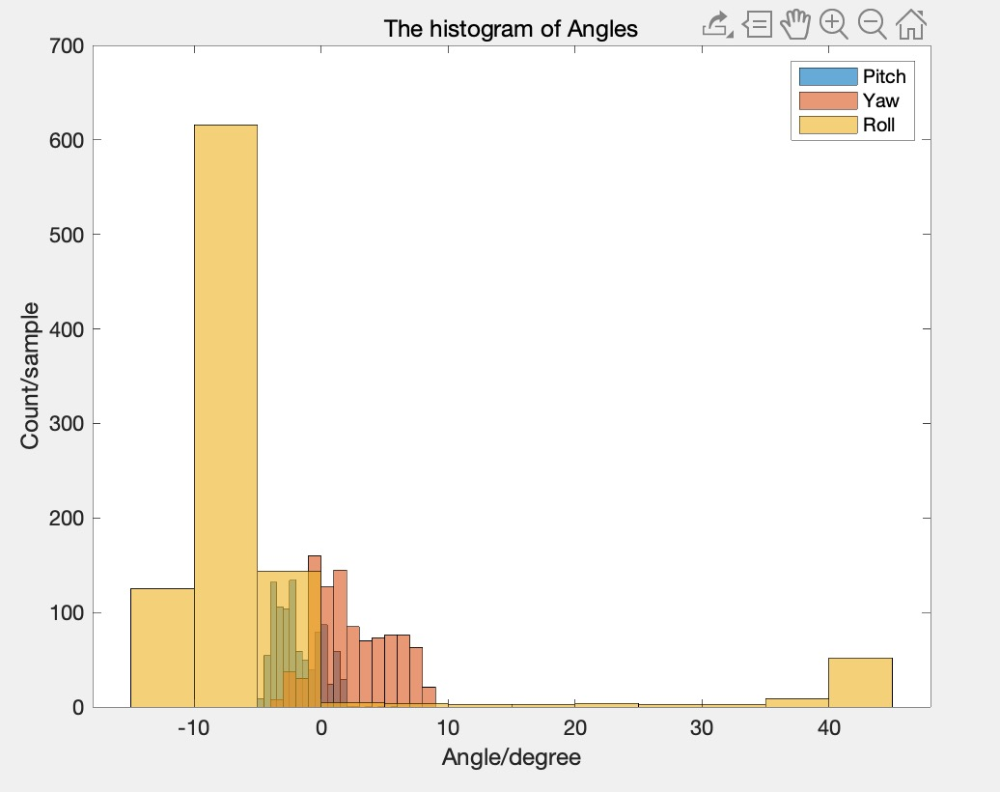
Mock OR Data Analysis – move shoulder
Pitch angle , Yaw angle, and Roll angle change little (almost zero degree).
Coordinate system figure from: https://stanford.edu/class/ee267/lectures/lecture10.pdf

Slide 15
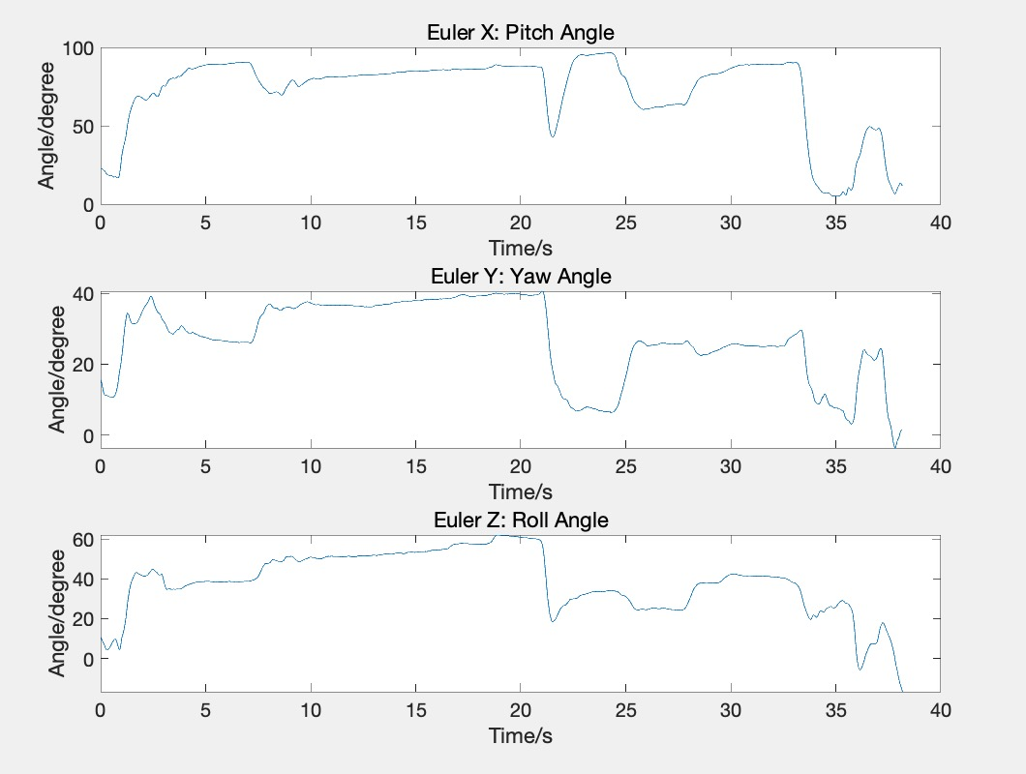
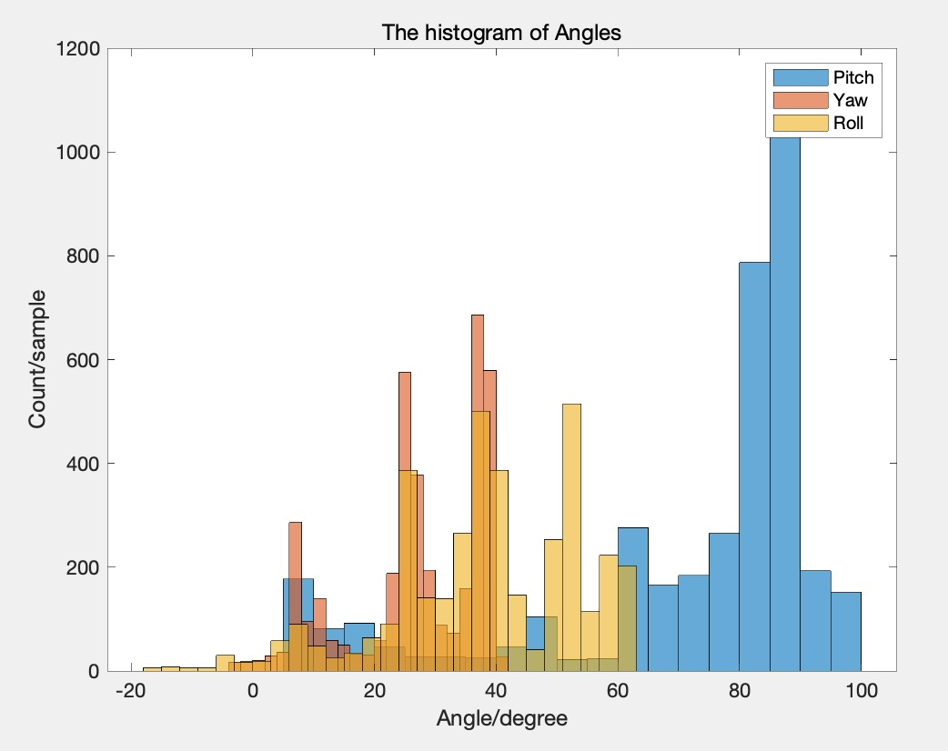
Mock OR Data Analysis – traditional case
Pitch angle keeps at 85 to 90 degree for a long time;
Yaw angle and Roll angle change between 0 to 60 degree, but they are not we concern about.
Coordinate system figure from: https://stanford.edu/class/ee267/lectures/lecture10.pdf

Slide 16
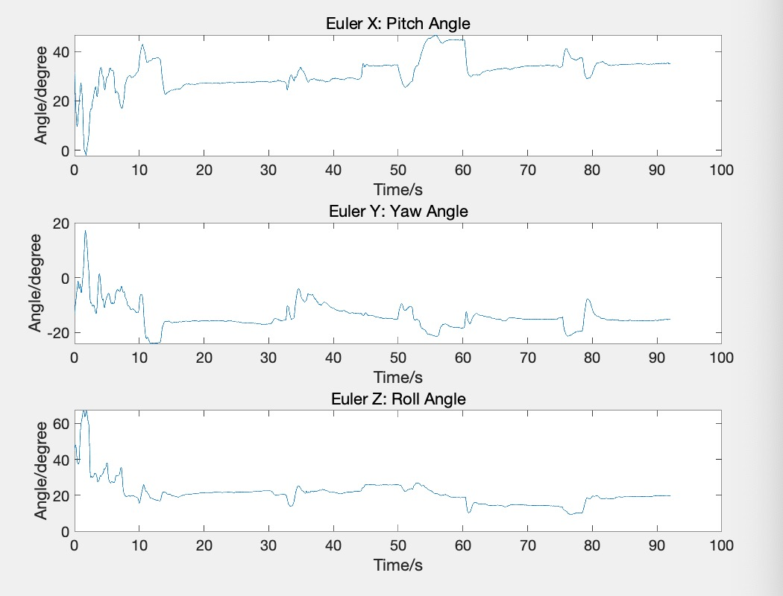
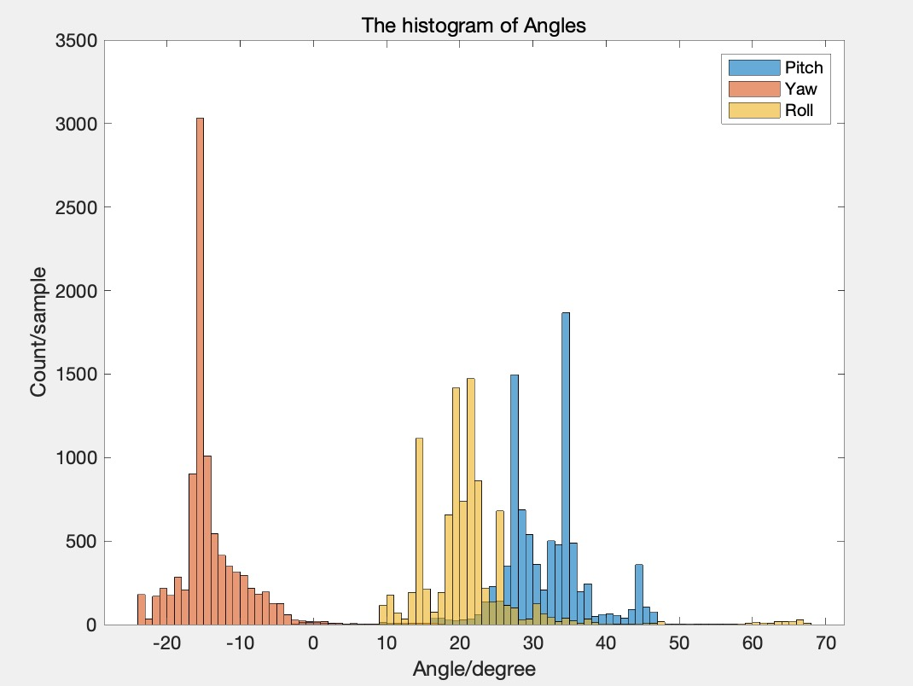
Mock OR Data Analysis – endoscopic case
Pitch angle keeps at 25 to 35 degree for a long time;
Yaw angle changes between -20 to 0 degree, and Roll angle changes between 10 to 30 degree, but they are not we concern about.
Coordinate system figure from: https://stanford.edu/class/ee267/lectures/lecture10.pdf

Slide 17
Milestones Update
Blue: Add & Revise;
Red: Delete;
Date | Detailed Description | Status
February, 21 | Linux and ROS environment configuration finished | Finished by Feb. 26
February, 26 | Project proposal finished | Finished by Feb. 26
February, 26 | Human Subjects Research Training finished | Finished by Feb. 26
March, 6 | Calibration of IMUs and mathematic model derivation finished | Finished by Mar. 21
March, 6 | Documentation of environment configuration and calibration method finished | Finished by Mar. 5
March, 11 | IRB approval | Finished by Mar. 10
March, 11 | First measure in Mock OR and analysis of the data finished | Finished by Mar. 21
April, 17 | 20 measurements in real surgery and analysis of the data finished Analysis of all the possible surgeries finished | In progress
April, 24 | Analysis of the difference between various surgery scenarios finished Analysis of the difference between emergency surgeries and simulation surgeries of residents | Not start
April, 24 | Documentation of data collection and data analysis finished | Not start
May, 4 | Clinical paper finished Final report finished | Not start

Slide 18
Time Schedule Status
Checkpoint day
Blue: Add & Revise;
Red: Delete;
 | Feb,15 -Feb,21 | Feb,22-Feb, 28 | Feb,29-Mar, 6 | Mar,7-Mar,11 | Mar,12-Mar,20 | Mar,21-Mar,27 | Mar,28-Apr,3 | Apr,4 - Apr,10 | Apr,11-Apr,17 | Apr,18-Apr,24 | Apr,25-May,1 | May,1-May,5
Set up the computer and document installation steps | ✅ | ✅️ | ✅
Calibration and document steps Derive mathematical model of neck angle and document steps |  | ✅ | ✅ |  | ✅ | ✅
First measurement in Mock OR & First data analysis |  |  |  | ✅ | ✅ | ✅
Human Subjects Research Training and IRB approval | ✅ | ✅ | ✅ | ✅
20 measurement in real surgery scenarios & Each one do data analysis Data analysis of some possible surgeries data from Deepa |  |  |  |  | ☑️ | ☑️ | ☑️ | ☑️ | ☑️
Overall analysis and documentation of the difference between various scenarios all the data analysis |  |  |  |  |  |  |  | ☑️ | ☑️ | ☑️
Write clinical paper Write final report |  |  |  |  |  |  |  |  |  | ☑️ | ☑️ | ☑️
Recalculate
✅ : Finished stuff ☑️ : Planned stuff

Slide 19
Dependencies Status
Blue: Add & Revise;
Red: Delete;
Dependencies | How to resolve | Alternative Plan | Date Expected | Date Needed
IRB approval | 1. Finish Human Subjects Research Training on Mylearning 2. Get IRB approval with the help of Dr. Deepa Galaiya | Do all the measurement in Mock OR | 1. Feb,24 2. Mar,6 | 1. Feb,26(Solved) 2. Mar,11(Solved)
Computer with Linux & ROS | 1. Our own computers for calibration 2. Another computer for data collection sponsored by Dr. Taylor, discussed with Deepa and Anton | Use backup files in another computer | 1. Feb, 14 2. Mar, 6 | 1. Feb,19 (Solved ) 2. Mar,12 (Solved)
Two IMUs | Provided by Dr. Deepa Galaiya | Buy two new IMUs sponsored by Dr. Taylor, discussed with Anton | Feb, 14 | Feb,19 (Solved)
IMU related software in Linux (Packages included Lpms-imu and ndi_tracker_ros) | Installation from Galen-Trackers GitLab with the help of Anton | In Windows, install Lpms_control Software | Feb,19 | Feb,21 (Solved)
EM tracker for Calibration | Get the access to Mock OR | Optical Tracker | Feb, 19 | Feb,21 (Solved)
Phantom study data | Deepa do mock surgery in Mock OR | With the help of graduate student | Mar,1 | Mar,6 (Solved)
Actual surgery data | Get data from Samuel who is responsible for collecting actual surgery data in medical school | Do all the measurement in Mock OR Do emergency surgeries and simulation surgeries | Mar,10 | Mar,12 (Not start)
MATLAB for data analysis Dropbox for data saving | Installation | Python Google drive | Mar,1 | Mar,6 (Solved)

Slide 20
Thanks!

